Slide 1

SQL Injection Detection and Prevention Using Predictive Analytics GitHub link:https://github.com/SQL-Injection-Detecion-and-prevention/A14_CSE_2020
Batch No: A-14 Project Guide:
D.Alekhya 164G1A0502 Mrs.K.Sudha Kumari,M.Tech.
K.Anitha 164G1A0504 Assistant Professor
V.Ajay Kumar 164G1A0501
Srinivasa Ramanujan Institute of Technology
Department of Computer Science & Engineering

Slide 2
Introduction
While transferring data from cloud hosted web applications to IoT smart devices intruder have an advantage of attacking web applications to steal the data from the database in the form Structured Query Language Injection Attack (SQLIA)
This can cause serious repercussions especially on monetary transactions.

Slide 3
Abstract
Structured Query Language Injection Attack (SQLIA) remains an intruder’s exploit of choice on vulnerable web applications to pilfer confidential data from the database with potentially damaging consequences.
Here a trained classifier to be deployed as a web service that is consumed in a application implementing a web proxy Application Programming Interface (API) to intercept and accurately predict SQLIA in web requests.
Thereby preventing malicious web requests from reaching the protected back-end database.

Slide 4
Existing system
Existing systems are static analysis technique which validate the user input type in order to reduce the chances of SQL injection attacks.
AMNESIA, in this approach the application code itself contains information to produce all the possible SQL queries that could be generated by the application.
But this AMNESIA tool has its own set of drawbacks, biggest one being that it is not a hundred percent accurate and could generate a lot of false positives.

Slide 5
Proposed System
In proposed system, we build a predictive analytics web application with quantities of learning data to train a classifier.
It provide a representative data set that train a model implementing Support Vector Machine (SVM) algorithm.
This can accurately predicts SQLIA thereby preventing malicious web requests from reaching the target back-end database.

Slide 6
Module Description
Admin module
User Details: In this admin can view all the users details that who are using the application.
Upload Document: The admin can upload the important documents that are useful to the user.
View Document: The admin can view the documents what he had uploaded.
Attack Details: Admin will get the SQL injection attack details that was happened on user page.
Graphical analysis: Admin will get the graphical analysis of attack details.

Slide 7
User Module
My details: Here he can view his details what he has given at the time of registration
Home page: It contains the documents that admin has uploaded.
Check Website: In this he can check whether the website vulnerability he is checking is SQL injection attack website or not.
View Website: He can view what websites he has checked for attack.

Slide 8
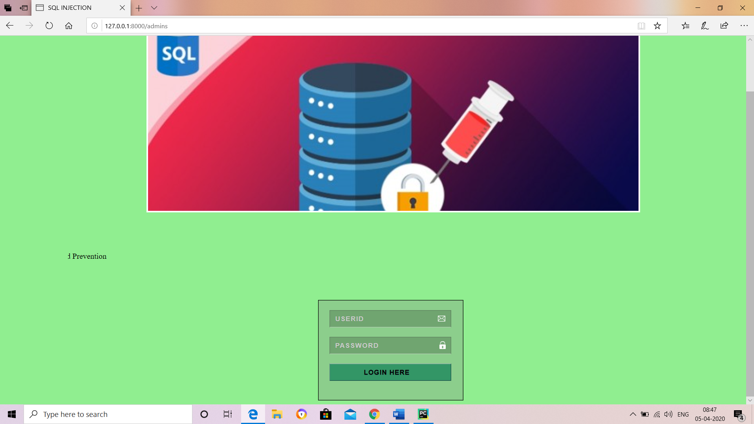
Results
Admin module

Slide 9
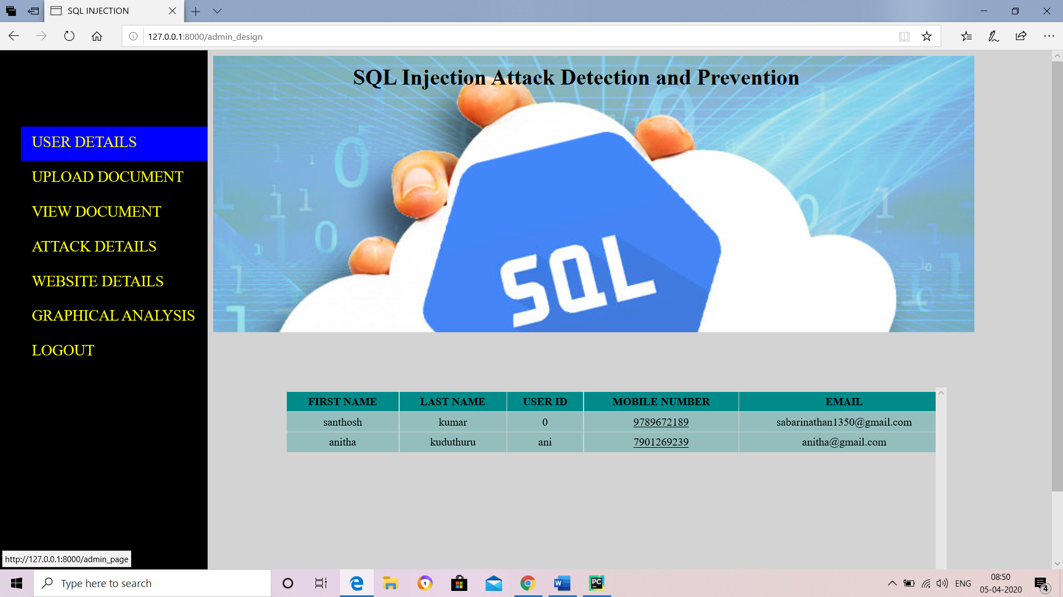

Slide 10
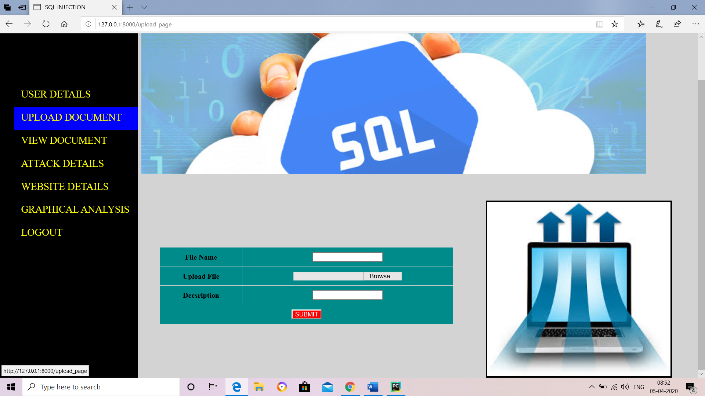

Slide 11
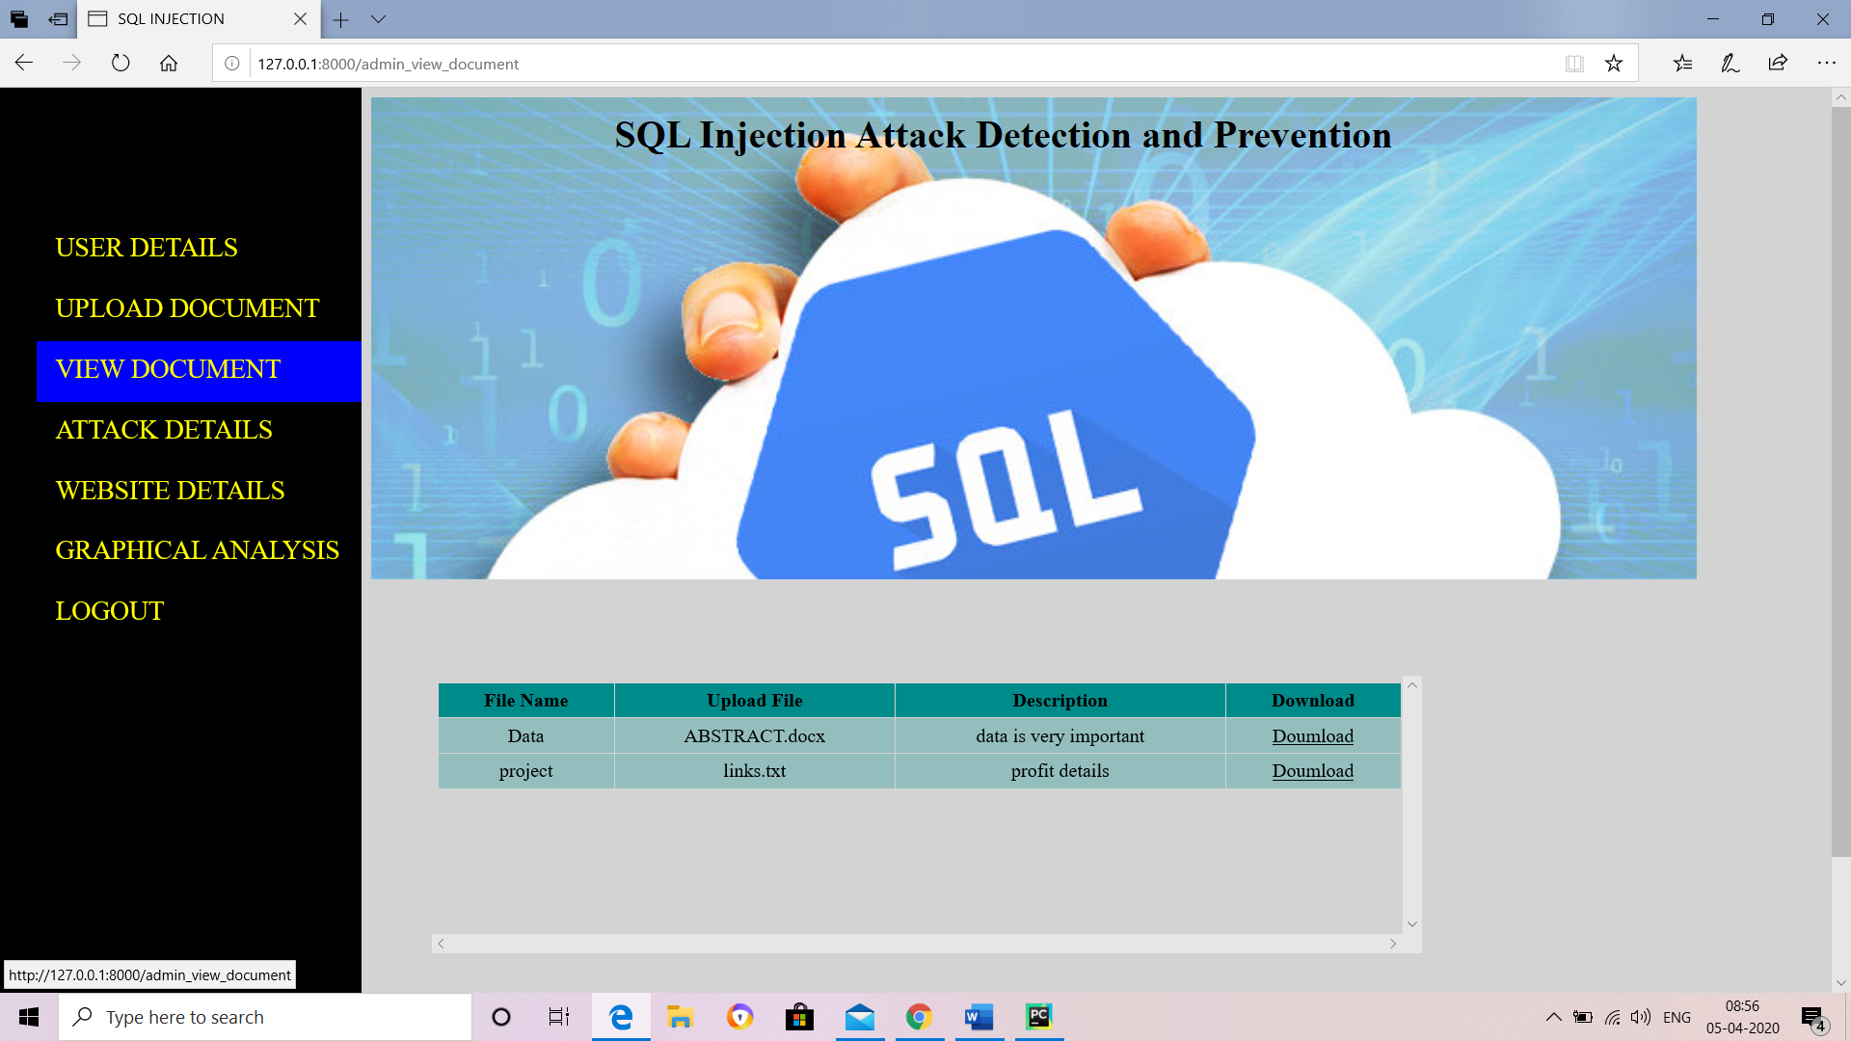

Slide 12
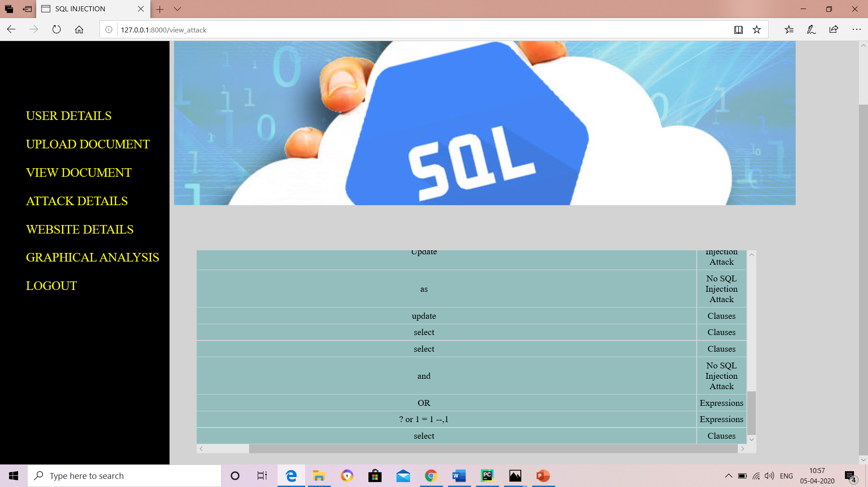

Slide 13
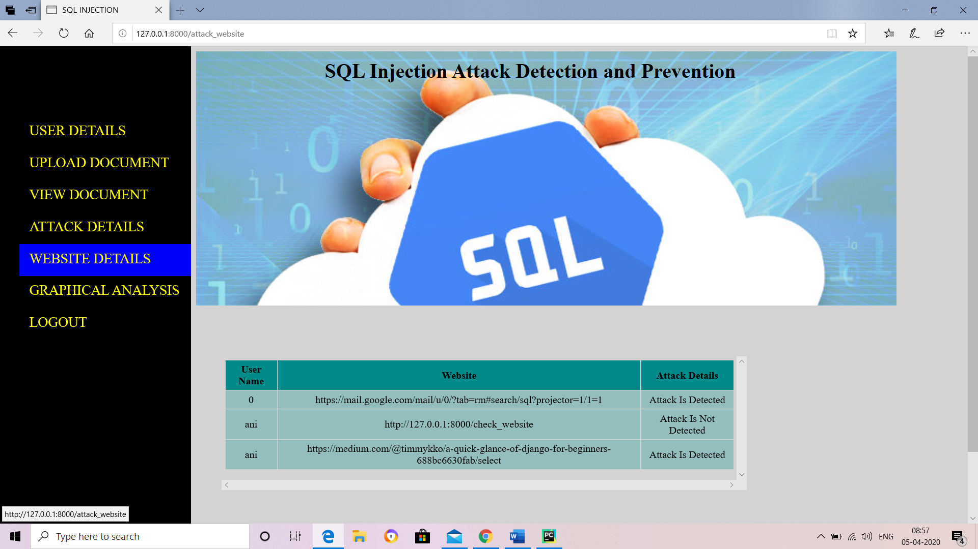

Slide 14
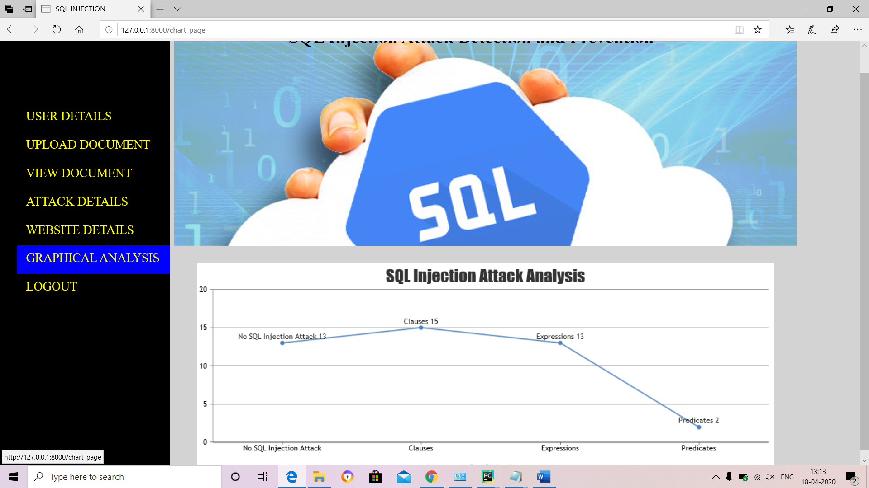

Slide 15
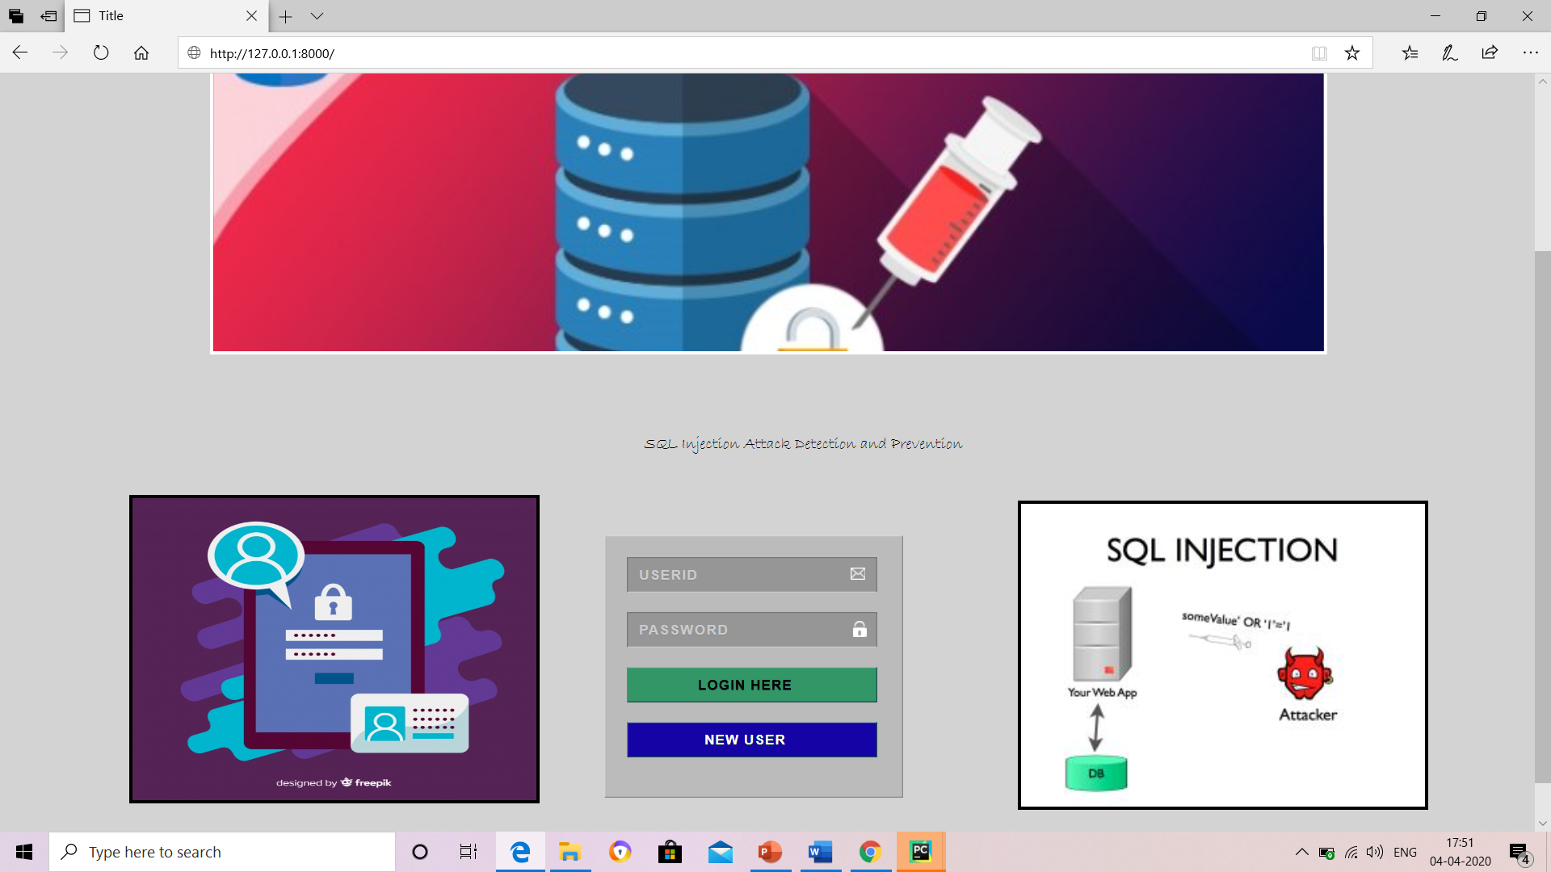
User

Slide 16
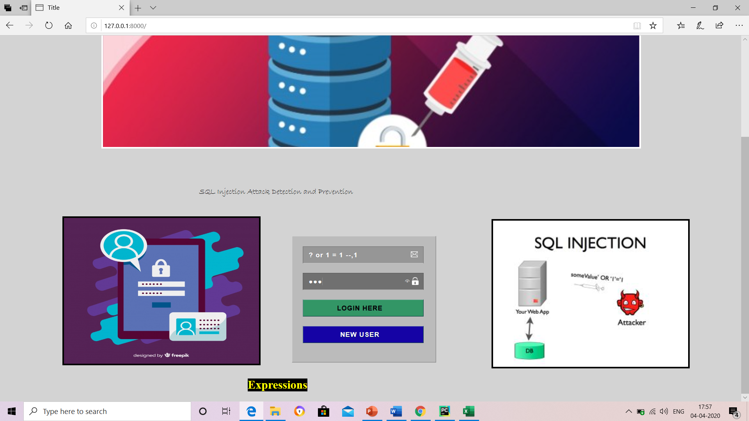

Slide 17
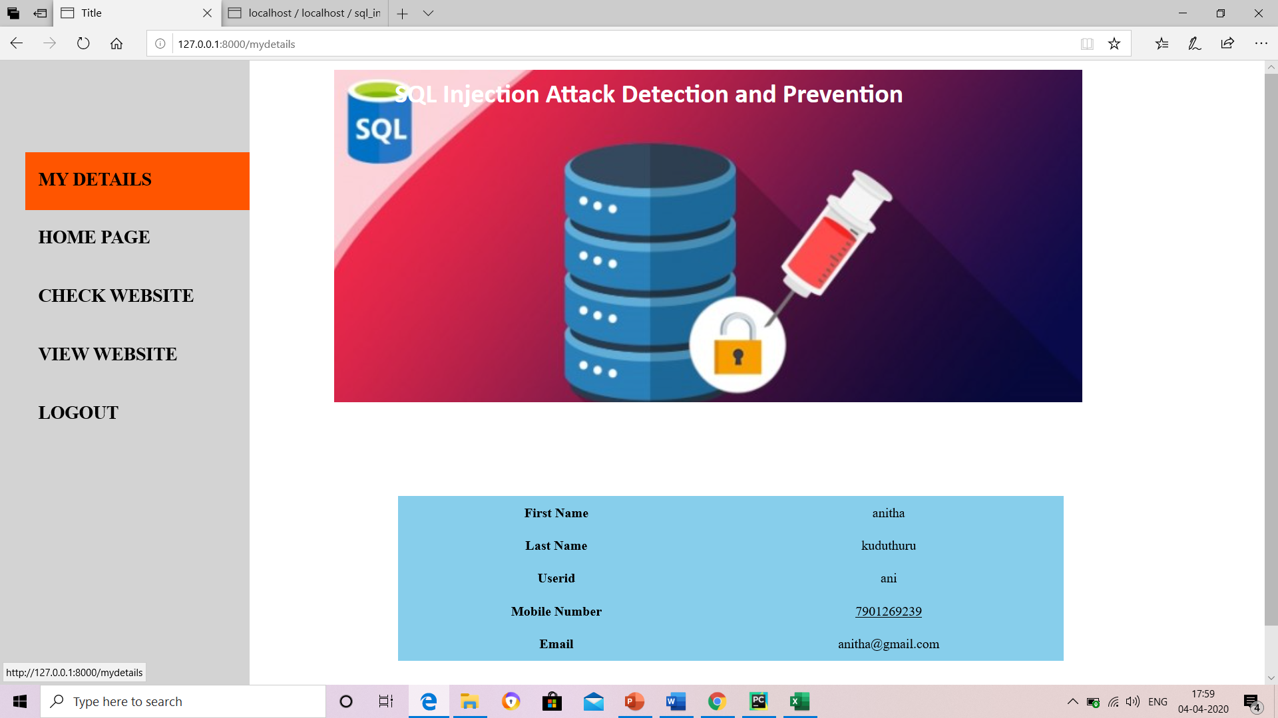

Slide 18
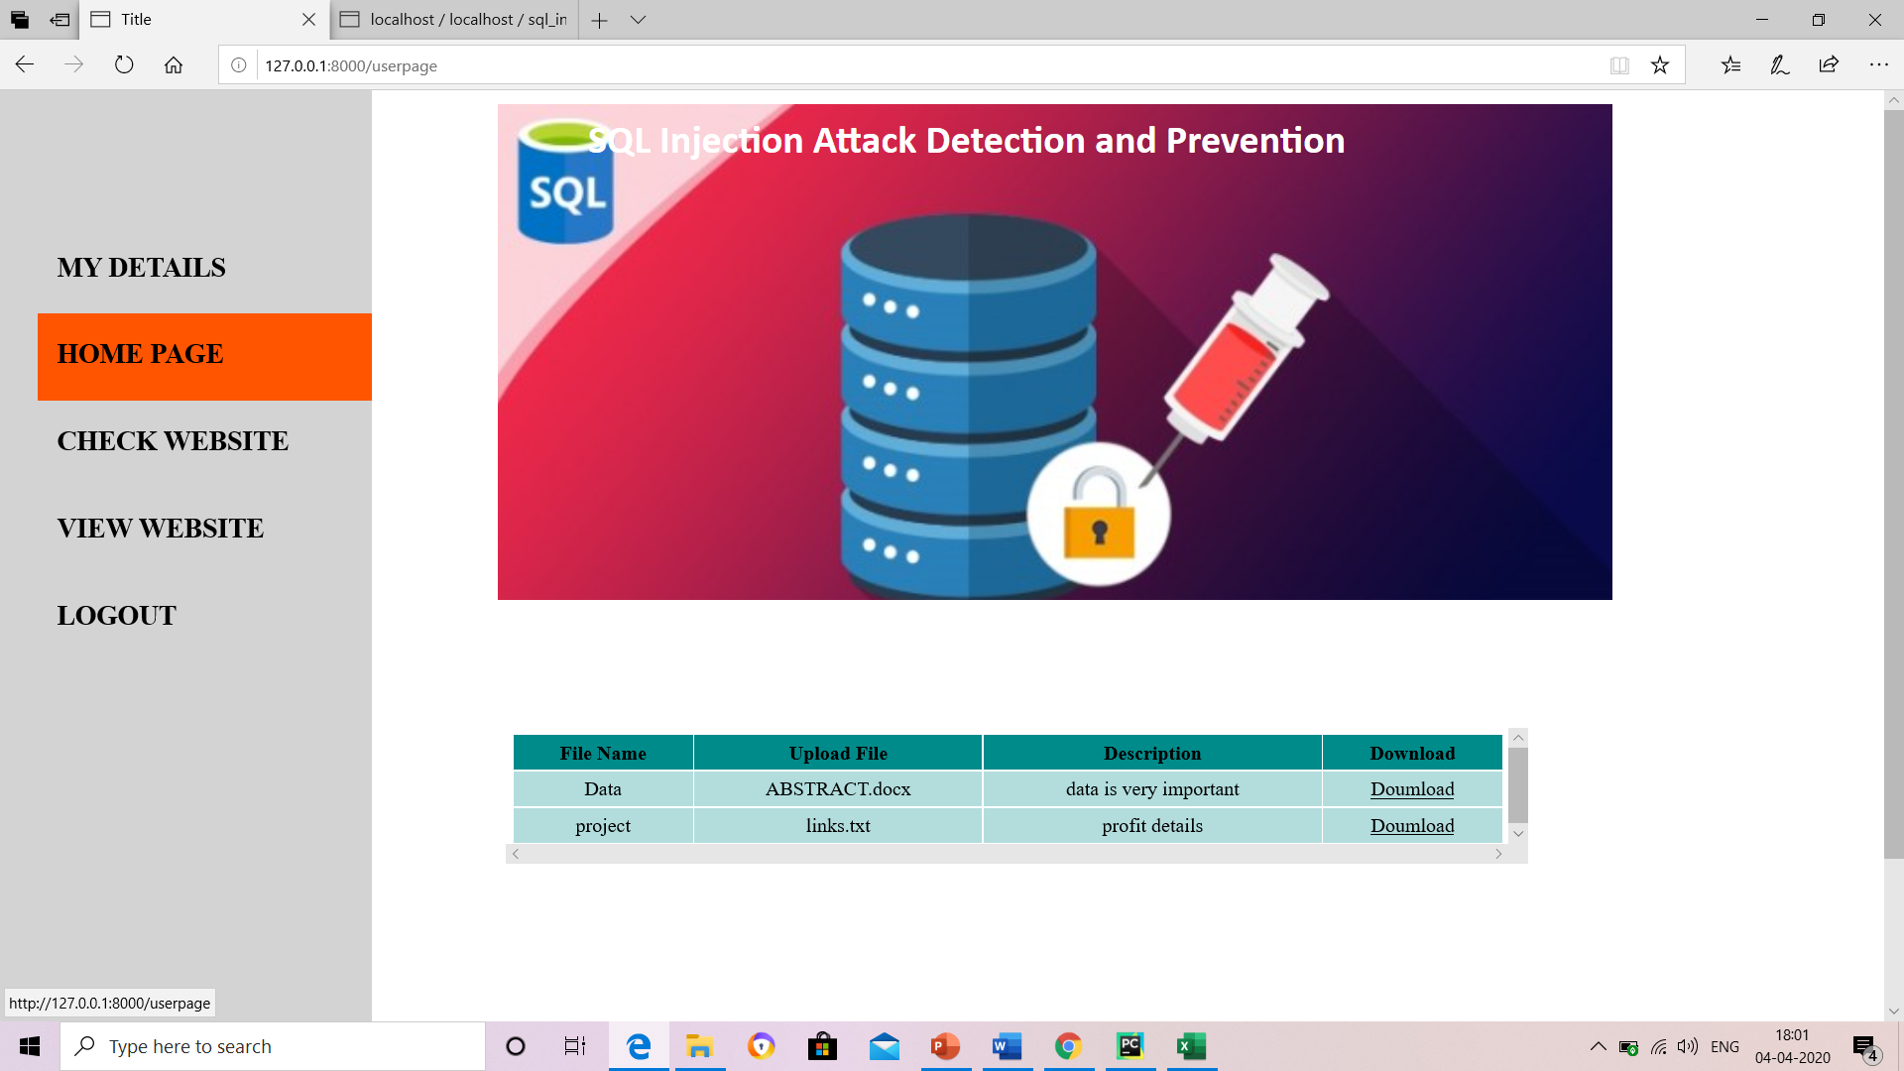

Slide 19
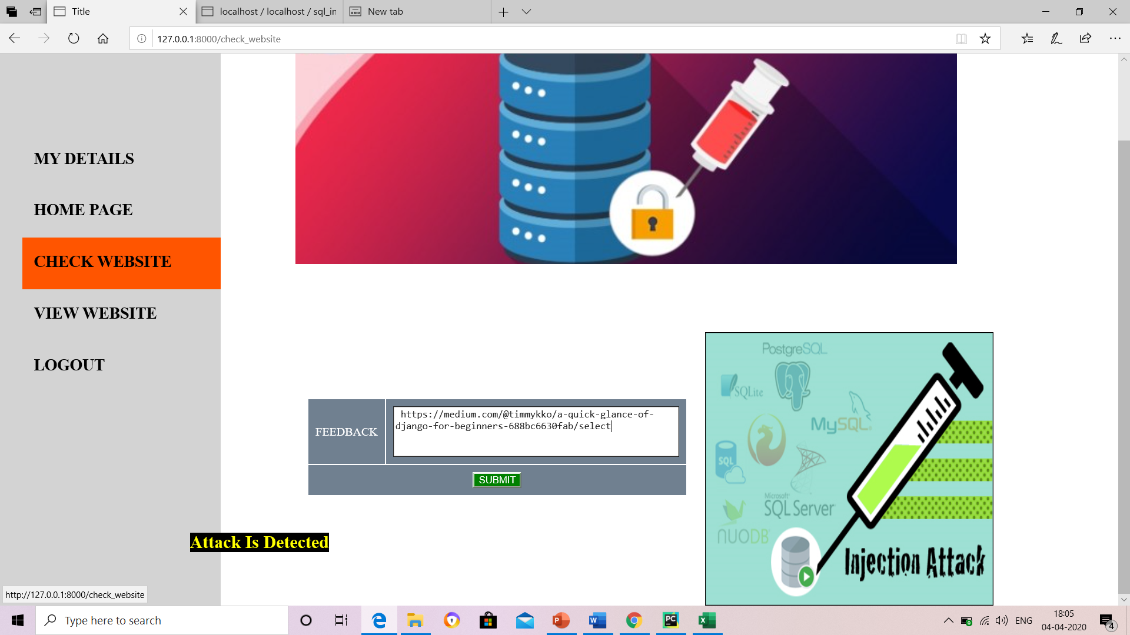

Slide 20
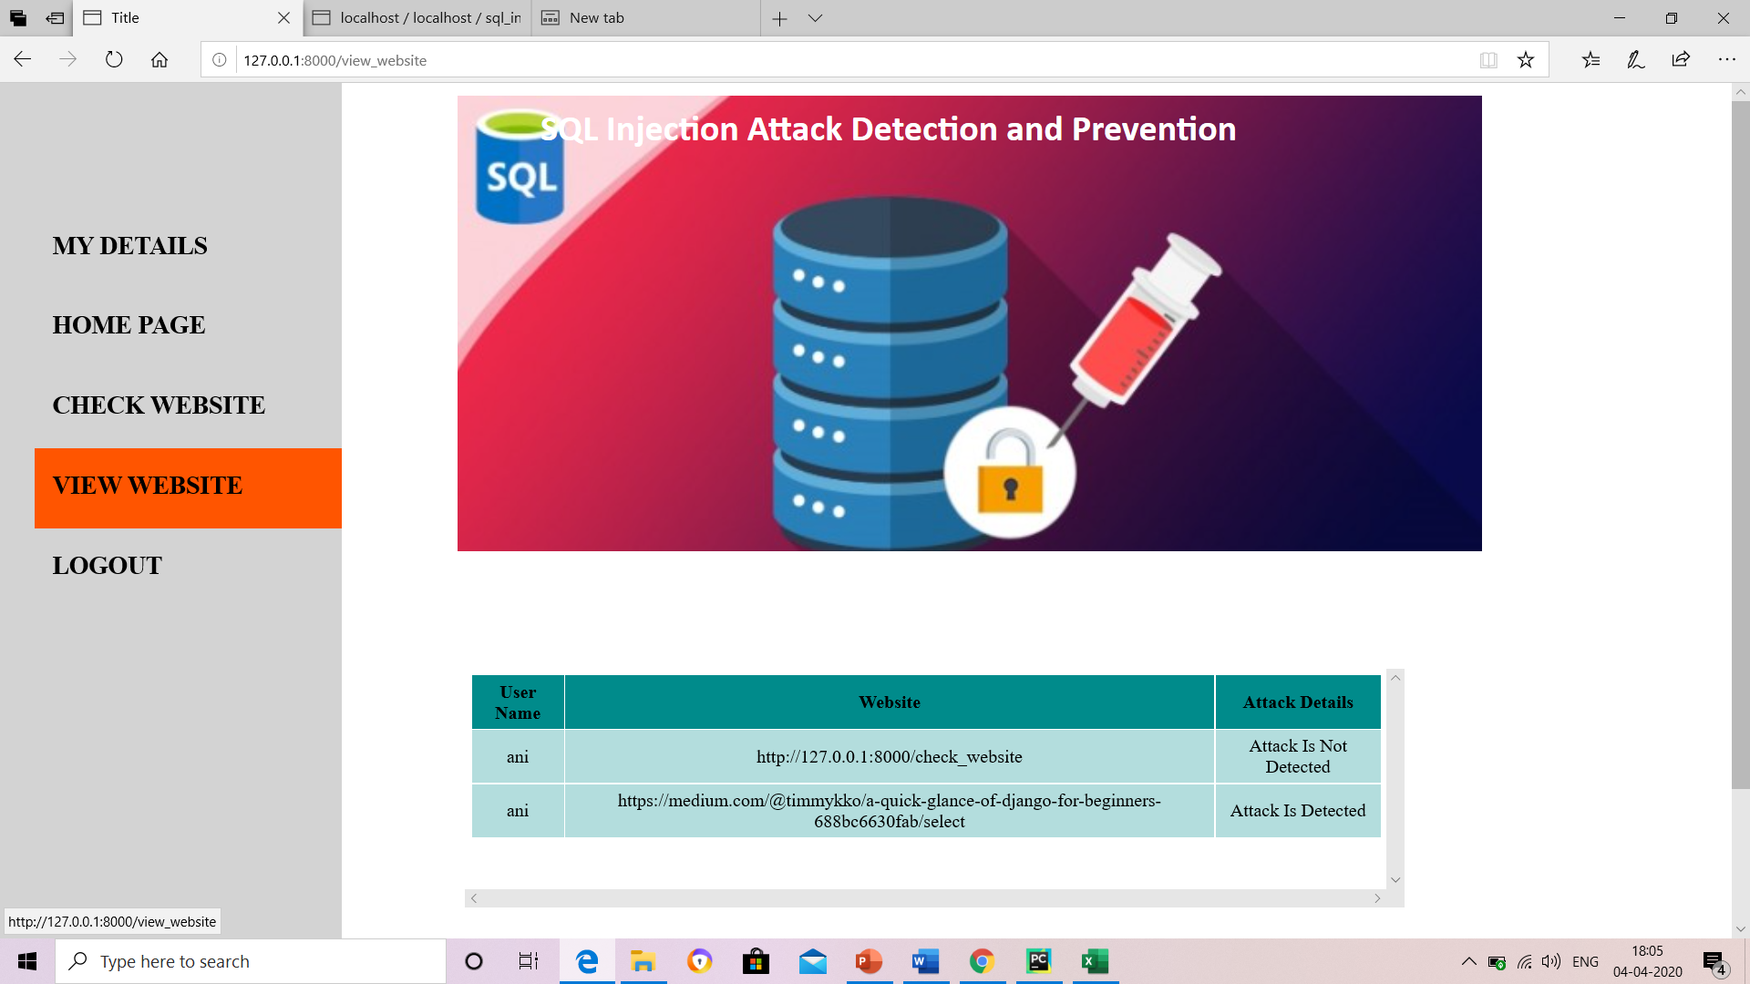

Slide 21
Conclusion
SQL injection attack is a very serious problem of web applications. Finding the efficient solution of this problem is essential. Researchers have developed many techniques to detect and prevent this vulnerability. There is no appropriate solution that can prevent SQL injection attacks.
So we demonstrated in this paper applied predictive analytics to SQLIA detection and prevention in big data context with an excellent result.
In benchmarking this paper against existing works, the methodology proposed here is functional in a big data context which is lacking in existing works before now on SQLIA to our knowledge. Future work involves employing multi-class classifier to identify and group the different SQLIA types as they are predicted.

Slide 22
References
https://viterbi-web.usc.edu/~halfond/papers/halfond05ase.pdf
https://www.researchgate.net/publication/310454603_SQL_injection_prevention_system

